Slide 1
Introduction to Queueing Theory
Shovan Bhowmik
Lecturer
Dept. of Cse(Baiust)

Slide 2
Queueing System
Waiting for service is part of our daily life. We queue up for: bus, check out counter etc.
Not only for human, jobs wait to be processed on a machine as well
But first let’s understand Queue…
Queue: A line of people or vehicles awaiting for their turn.
Queueing System: A queueing system is a facility consisting of one or several servers designed to perform certain tasks or process certain jobs and a queue of jobs waiting to be processed.

Slide 3
Queueing System(Cont..)
Examples of Queueing System are:
a personal or shared computer executing tasks sent by its users;
an internet service provider whose customers connect to the internet, browse, and disconnect;
a TV channel viewed by many people at various times;
a toll area on a highway, a fast food drive-through lane, or an automated teller machine (ATM) in a bank, where cars arrive, get the required service and depart;
a medical office serving patients and so on.

Slide 4
Queueing System(Cont..)
Queueing Theory: It is the mathematical study of Waiting line/Queue. This technique provides the basis of decision making about the resources needed to provide a service.
Reason of Queue:
A queue is formed when a customer is made to wait due to the fact that no. of customers are more than the service providers.
Or,
The serving time to a customer is more than the arrival time of the customer.

Slide 5
Queueing System(Cont..)
Reason to study Queue
To find out the cost of offering the service
To find out the cost incurred due to delay in offering service
To allocate the resources

Slide 6
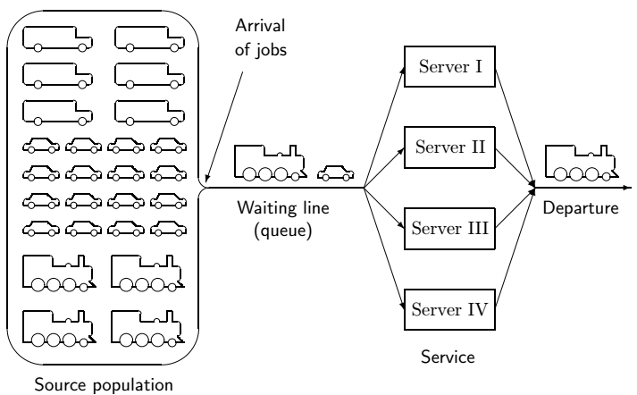
Components of a Queueing System

Slide 7



Components of a Queueing System(Cont..)
Arrival: Jobs arrive at queueing system at random times.
For any t>0, which is the expected no. of arrivals per unit time.
So, the expected time between arrival is:
Service: Once a server becomes available, it immediately starts processing the next assigned job. The service rate is defined as follows:

Slide 8
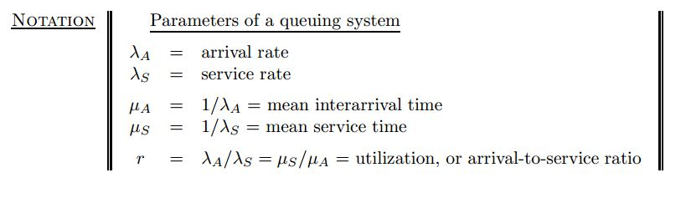
Components of a Queueing System(Cont..)
Departure: When the service is completed, the job leaves the system.
The followings are the parameters of a queueing system:

Slide 9
Queueing System – Input Process
Usually called the arrival process.
Arrivals are called customers.
We assume that no more than one arrival can occur at a given instant.
If more than one arrival can occur at a given instant, we say that bulk arrivals are allowed.
Models in which arrivals are drawn from a small population are called finite source models.
If a customer arrives but fails to enter the system, we say that the customer has balked.

Slide 10
Queueing System – Output Process
To describe the output process of a queuing system, we usually specify a probability distribution – the service time distribution – which governs a customer’s service time.
The service time distribution is independent of the number of customers present.
Two arrangements of servers:
Servers are in parallel if all server provide the same type of service and a customer need only pass through one server to complete service.
Servers are in series if a customer must pass through several servers before completing service.

Slide 11
Queueing System – Queue Discipline
Describes the method used to determine the order in which customers are served.
The most common - FCFS discipline (first come, first served), served in order of their arrival.
LCFS discipline (last come, first served), the most recent arrivals are the first to enter service.
Customer is randomly chosen from waiting line - SIRO discipline (service in random order).
Priority queuing disciplines - classifies each arrival into one of several categories. Each category is then given a priority level, and within each priority level, customers enter service on an FCFS basis.

Slide 12

Modeling Arrival Process
We define t_{i} to be the time at which the i-th customer arrives.
We define T_{i} = t_{i+1} - t_{i} to be the i-th interarrival time.
In modeling the arrival process we assume that the T_{i}’s are independent, continuous random variables described by A having a density function a(t).
The assumption that each interarrival time is governed by the same random variable implies that the distribution of arrivals is independent of the time of day or the day of the week.
This is the assumption of stationary interarrival times.

Slide 13
Modeling Arrival Process(Cont..)
Stationary interarrival times is often unrealistic, but we may often approximate reality by breaking the time of day into segments.
A negative interarrival time is impossible. This allows us to write:
We define λ to be the arrival rate
So 1/λ to be the mean or average interarrival time. Time is measured in units of hours.

Slide 14
Modeling Arrival Process(Cont..)
How to choose A - to reflect reality and still be computationally tractable.
The most common choice for A is the exponential distribution.
An exponential distribution with parameter λ has a density
a(t) = λe^{-λt.}
We can show that the average or mean by
Variance by

Slide 15
Modeling Arrival Process(Cont..)
Lemma 1: If A has an exponential distribution, then for all nonnegative values of t and h.
For reasons that become apparent, a density that satisfies the equation is said to have the no-memory property.
The no-memory property of the exponential distribution is important because it implies that if we want to know the probability distribution of the time until the next arrival, then it does not matter how long it has been since the last arrival.

Slide 16

Modeling Service Process
We assume that the service time of different customers are independent random variables and that each customer’s service time is governed by a random variable S having a density function s(t).
We let 1/µ be then mean service time for a customer.
So µ is service rate.
As with interarrival times, we hope that service times can be accurately modeled as exponential random variables
Unfortunately, actual service times may not be consistent with the no-memory property.

Slide 17
The Kendall-Lee Notation for Queueing Systems
Standard notation used to describe many queueing systems.
The notation is used to describe a queuing system in which all arrivals wait in a single line until one of s identical parallel servers id free. Then the first customer in line enters service, and so on.
To describe such a queueing system, Kendall devised the following notation.
Each queuing system is described by six characters 1/2/3/4/5/6.

Slide 18
The Kendall-Lee Notation for Queueing Systems(Cont..)
The first characteristic specifies the nature of the arrival process. The following standard abbreviations are used:
M = Interarrival times are independent, identically distributed (iid) having an exponential distribution.
D = Interarrival times are iid and deterministic
E_{k} = Interarrival times are iid Erlangs with shape parameter k.
GI = Interarrival times are iid and governed by some general distribution

Slide 19
The Kendall-Lee Notation for Queueing Systems(Cont..)
The second characteristic specifies the nature of the service times:
M = Service times are iid and exponentially distributed
D = Service times are iid and deterministic
E_{k} = Service times are iid Erlangs with shape parameter k.
G = Service times are iid and governed by some general distribution

Slide 20
The Kendall-Lee Notation for Queueing Systems(Cont..)
The third characteristic is the number of parallel servers.
The fourth characteristic describes the queue discipline:
FCFS = First come, first served
LCFS = Last come, first served
SIRO = Service in random order
GD = General Queue Discipline
The fifth characteristic specifies the maximum allowable number of customers in the system.
The sixth characteristic gives the size of the population from which customers are drawn.

Slide 21
The Kendall-Lee Notation for Queueing Systems(Cont..)
In many important models 4/5/6 is GD/∞/∞. If this is the case, then 4/5/6 is often omitted.
M/E₂/8/FCFS/10/∞ might represent a health clinic with 8 doctors, exponential interarrival times, two-phase Erlang service times, an FCFS queue discipline, and a total capacity of 10 patients.

Slide 22
References
Operations Research Applications and Algorithms(4th Edition) – Wayne L. Winston
Probability and Statistics for Computer Scientists(2nd Edition) – Michael Baron

Slide 23


